Slide 1
超連鎖事業新工具與SHOP.COM的優化功能 New Tools of UnFranchise Business and Enhancements on SHOP.COM

Slide 3
Our company
ONGOING IMPROVEMENTS
Business building & duplication

Slide 4
RESULT PRODUCING ACTIVITIES
USE & SELL PRODUCTS
SHARE THE BUSINESS
SHARE THE
SHOPPING ANNUITY
SELL TICKETS
(EDUCATION)

Slide 5
UnFranchise.com >
Downloads >
Support Materials >
General Business Building >
Training
UnFranchise.com >
Downloads >
Support Materials >
General Business Building >
Training

Slide 6
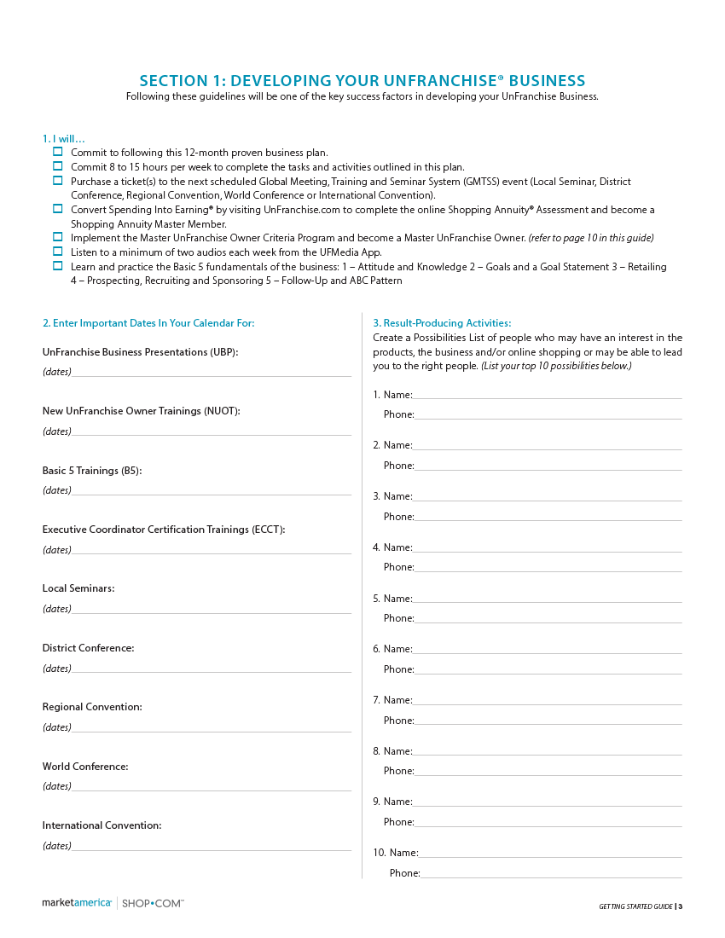

Slide 7
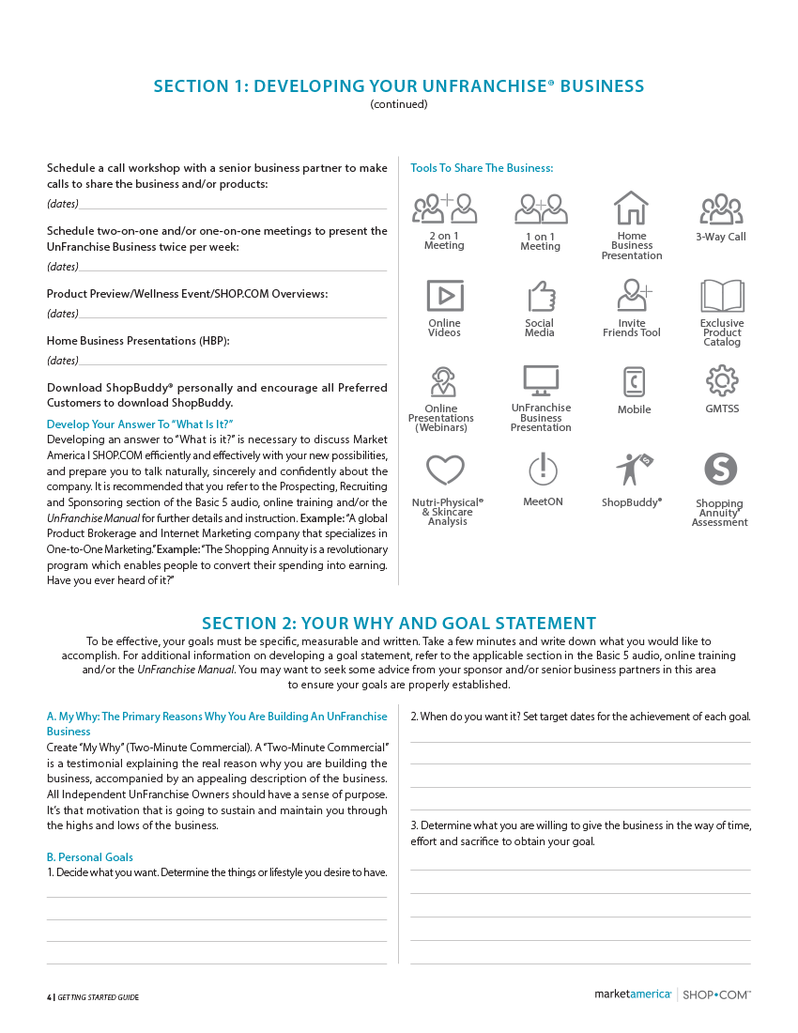

Slide 8
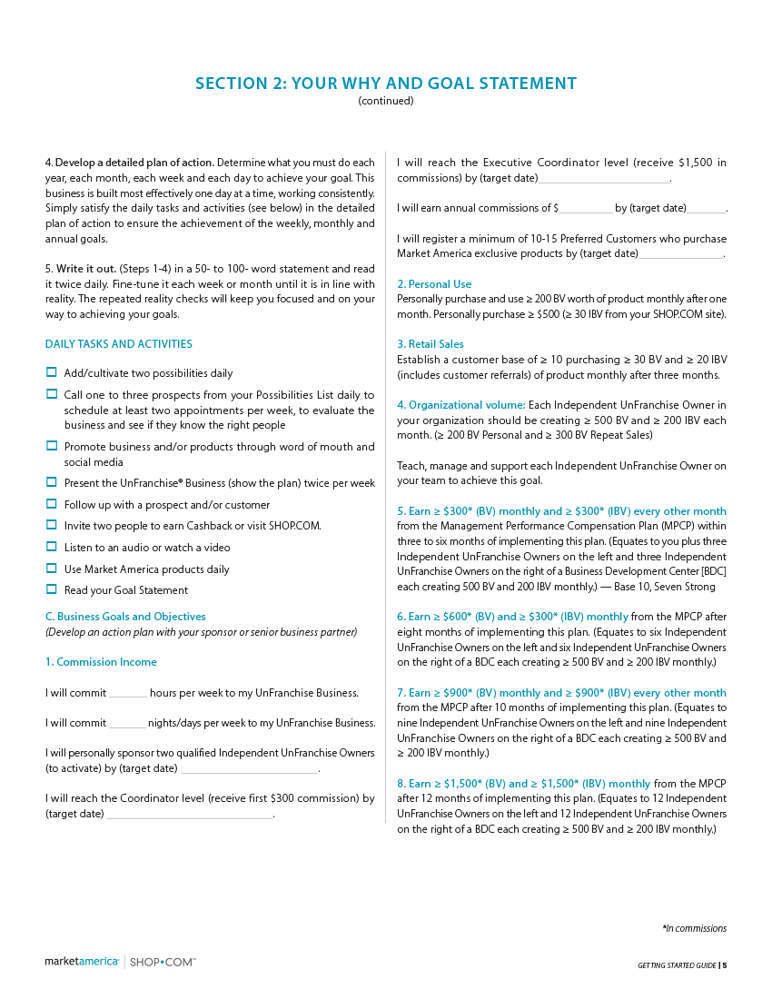

Slide 9
Master UnFranchise Owner (UFO) Program

Slide 10
AVERAGE ANNUAL COMMISSIONS
GREATER THAN TWO YEARS, BUT LESS THAN THREE YEARS: MASTER UFO EARNS 48% MORE THAN UFO ANNUALLY
GREATER THAN THREE YEARS, BUT LESS THAN FIVE YEARS:
MASTER UFO EARNS 48% MORE THAN UFO ANNUALLY
GREATER THAN FIVE YEARS, BUT LESS THAN SEVEN YEARS: MASTER UFO EARNS 102% MORE THAN UFO ANNUALLY
GREATER THAN SEVEN YEARS, BUT LESS THAN TEN YEARS: MASTER UFO EARNS 139% MORE THAN UFO ANNUALLY
GREATER THAN TEN YEARS: MASTER UFO EARNS 127% MORE THAN UFO ANNUALLY

Slide 11
MASTER UNFRANCHISE OWNER (UFO) CRITERIA CALENDAR QUARTERLY QUALIFICATIONS:
Complete the Shopping Annuity assessment.
Must have a subscription for the UnFranchise Management System (UFMS).
Purchase a total of 1500 BV of product for the respective quarter. These product purchases must be from your paying UnFranchise ID or from a personally registered Preferred Customer’s paying ID.
Generate $11500 worth of Partner Store purchases between you and your customers. These Partner Store purchases must be from your paying UnFranchise ID and/or from registered Preferred Customer’s paying ID.
Personally sponsor ONE qualified UnFranchise Owners

Slide 12
MASTER UNFRANCHISE OWNER (UFO) CRITERIA CALENDAR QUARTERLY QUALIFICATIONS:
Attend or conduct one New UnFranchise Owner Training (NUOT).
Attend or conduct one Basic 5 Training (B5).
Attend or conduct one Executive Coordinator Certification Training (ECCT) per calendar year.
Purchase a minimum of three tickets to Annual Convention and a minimum of three tickets to Leadership School.
Complete a Basic 5 Diagnostic Test, in which you score greater than or equal to 50 percent. AND/OR Earn a minimum of $6900 in commissions for the respective quarter (BV and/or IBV).

Slide 13
Master UFO
Online Submission

Slide 14
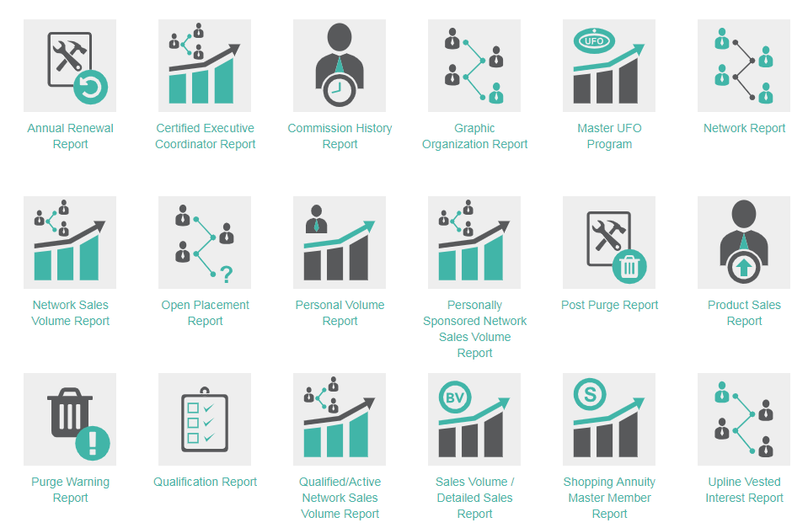
Select Master UFO Program

Slide 15
THE NEW SHOPPING ANNUITY PRESNTATION
INTRO
Traditional vs. Shopping Annuity
YOU’RE ALREADY SPENDING IT
New “hard-stop” questions
FOUR STEPS TO BUILD A SA
Shopping Annuity Assessment
Change Shopping Habits (BV 1st!!)
Automate your SA
Create Leverage
CLOSE
5 Ways we are changing the economy
It’s Your Choice

Slide 17
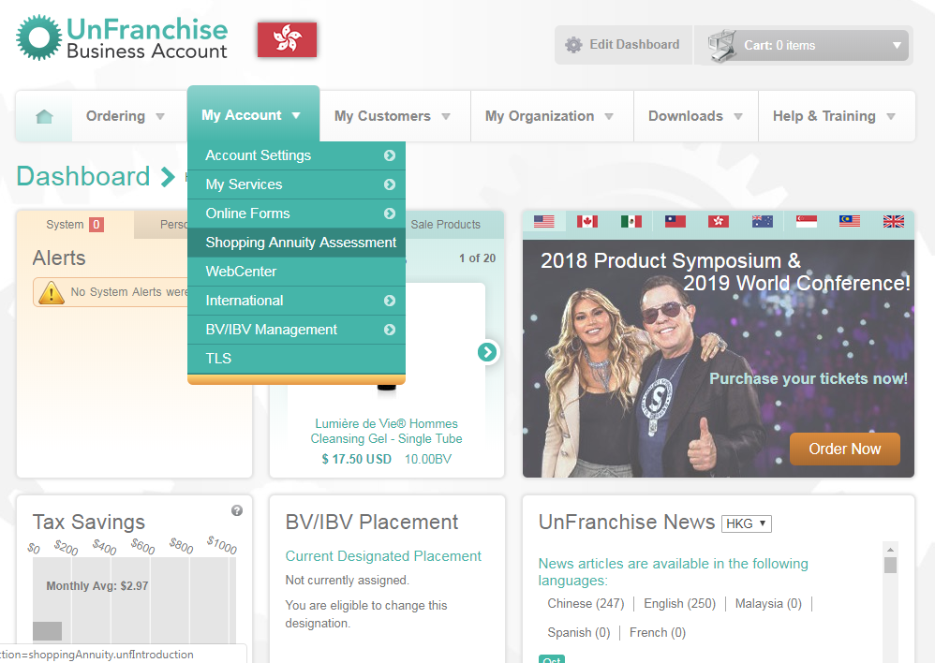
Notes:
HIGHLIGHTS
Condensed Assessment
Shows your prospect how much money they are already spending that could be redirected to fund a Shopping Annuity
Once completed you and your prospect will both be emailed a summary which will show the following based on their responses:
Total potential BV
Total potential IBV
SA at maturity at 3,5, 1o years if:
Built an organization of 12 and 12 doing the SA
If you added base 10, 7 Strong on top of that!

Slide 19
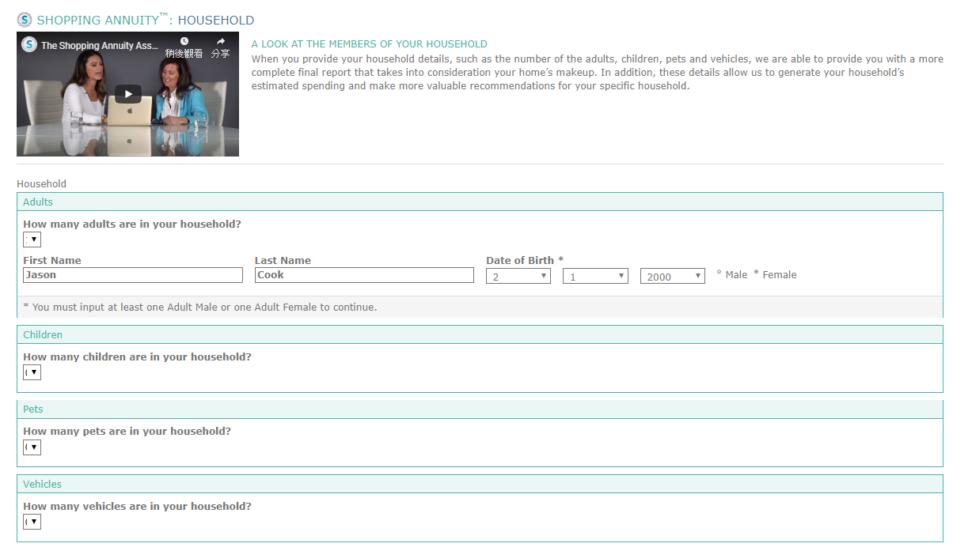

Slide 20
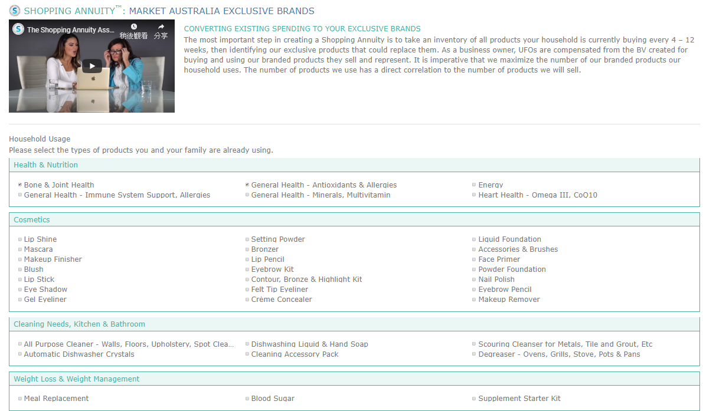

Slide 21
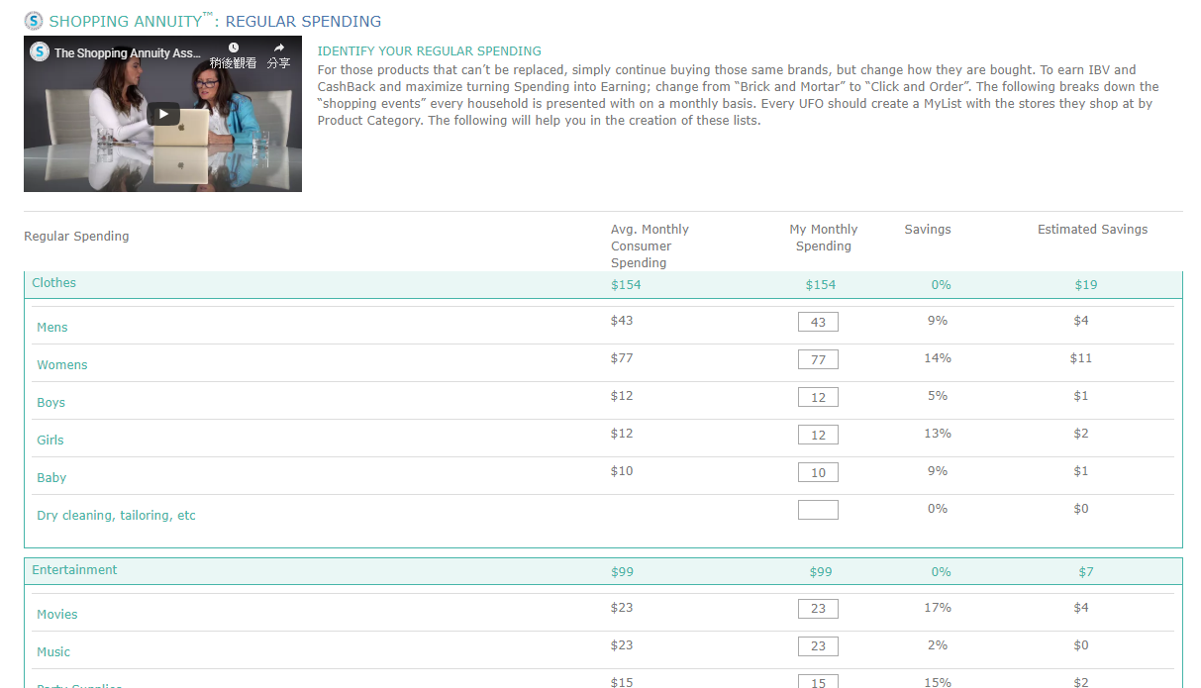

Slide 22
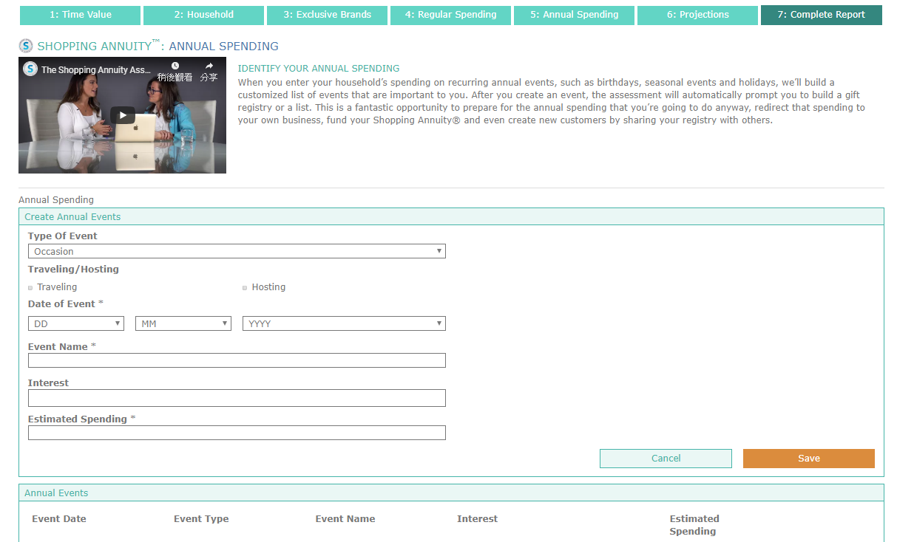

Slide 23
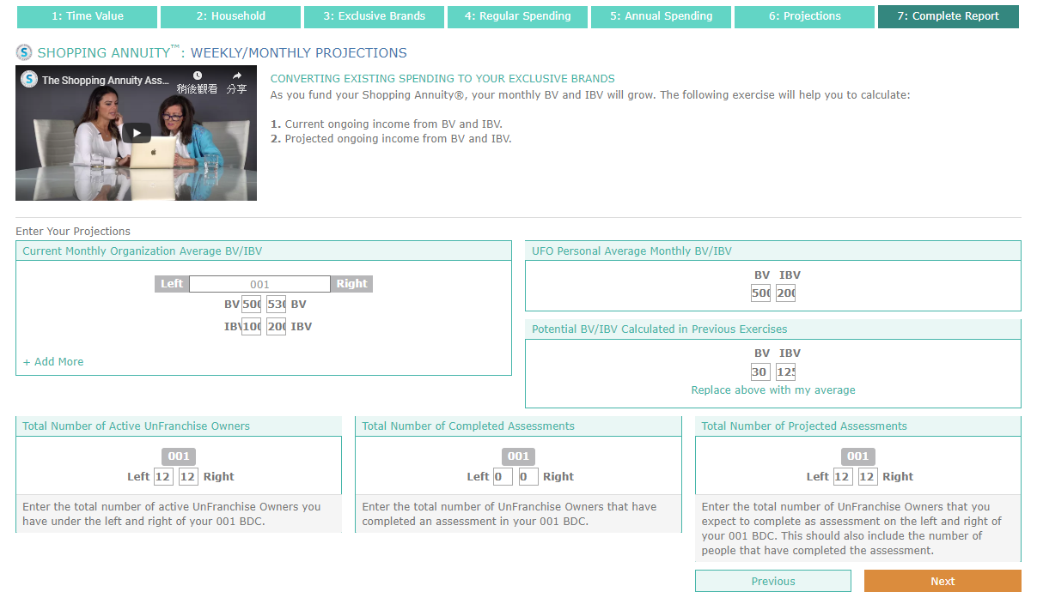

Slide 24
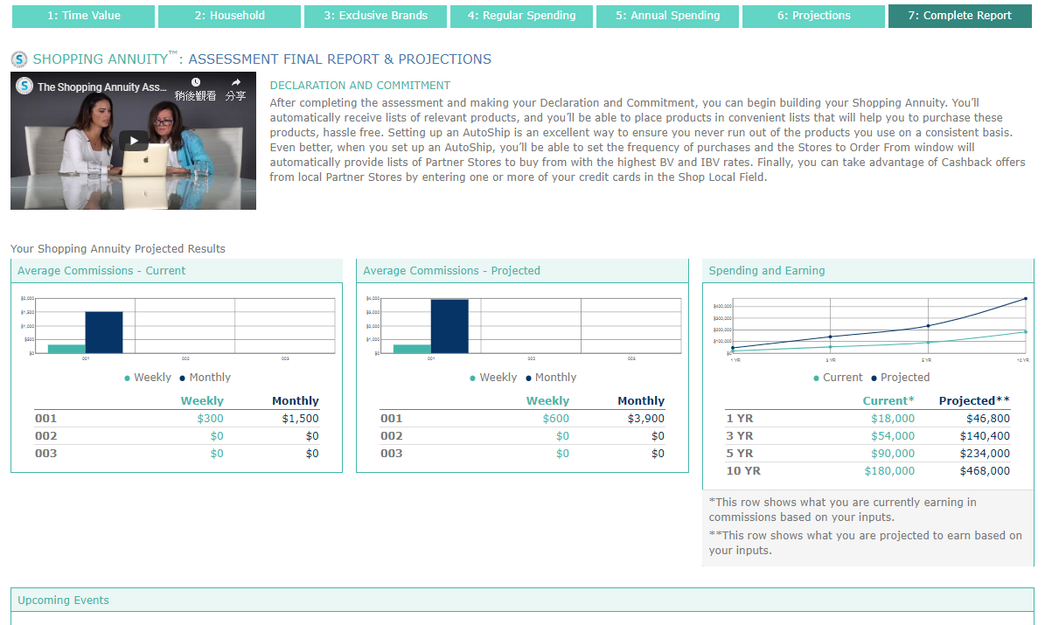

Slide 25
Shop Local new features

Slide 26
Launched! More venue information on ShopLocal
Notes:
https://hk.shop.com/shoplocal/location/389?latitude=22.2920704&longitude=114.17354239999999

Slide 27
Multi ShopLocal venues – Coming Soon

Slide 28
Store review function - Launched
Notes:
https://hk.shop.com/Apple+Music-v273193-c+.xhtml

Slide 29
THE TOTAL
PACKAGE!

Slide 30
Welcome
to Reality!

Slide 31
We are in
the News!!
Notes:
Thank you, News & Record for this great feature in the local paper! We're so proud of our Greensboro roots. “It’s ... inspiring to think that a company that started with just a handful of entrepreneurs has now blossomed into a global powerhouse,” - JR Ridinger Read the full online version here:http://bit.ly/2BR88PF

Slide 33
Entrepreneur.com Lauds Shopping Annuity as a Top Business Model
Entrepreneur.com is recommending the Shopping Annuity® and its home in the UnFranchise®Business as a top model for success for those who want to own their own business.
In “4 Effective Business Models That Built Billion-Dollar Companies,” entrepreneur.com lists the Shopping Annuity as a business model “worth studying in the context of today’s marketplace,” and says that JR’s vision for it “might just revolutionize the way e-commerce works.”

Slide 34
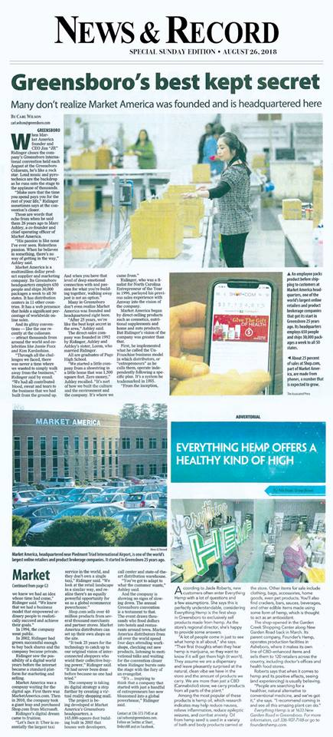
Market America | SHOP.COM Featured in Greensboro News & Record
The newspaper also interviewed Chairman and CEO JR Ridinger for “Market America Turns 26,” which begins with the energetic excitement of the Market America | SHOP.COM International Convention each fall. The article goes on to describe the rise of Market America | SHOP.COM from its humble 1992 start in Greensboro to its current position as a powerhouse company whose thousands of entrepreneurs retail products across the globe; SHOP.COM, the article says, “has a web presence that holds a significant percentage of worldwide online sales.”
Notes:
Thank you, News & Record for this great feature in the local paper! We're so proud of our Greensboro roots. “It’s ... inspiring to think that a company that started with just a handful of entrepreneurs has now blossomed into a global powerhouse,” - JR Ridinger Read the full online version here:http://bit.ly/2BR88PF

Slide 36
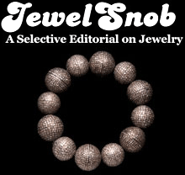
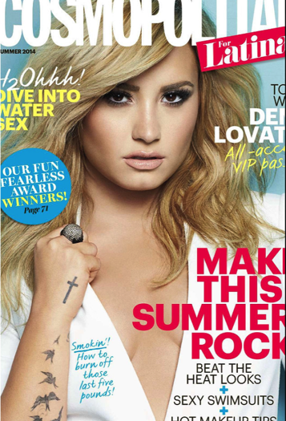
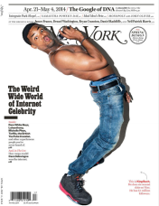
In the news

Slide 37
ranked
#65

Slide 38
ranked
#96

Slide 39
Ranked #1 Best Online Retailer by TheTopTens.com

Slide 40
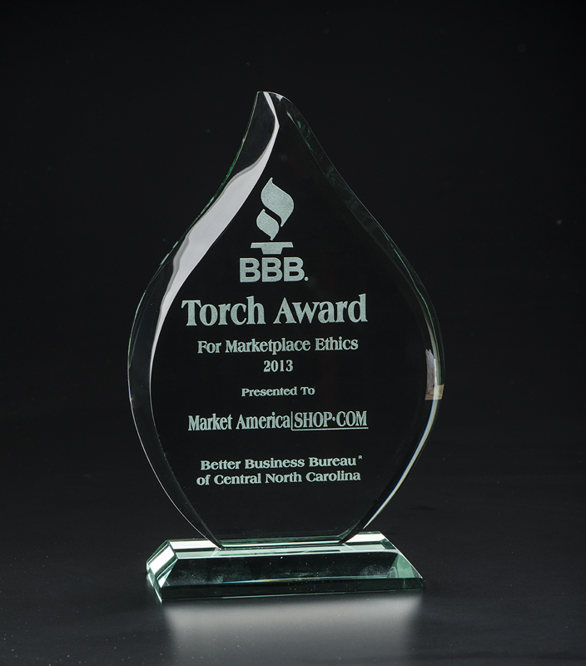
2013 & 2018 Torch Award Winner
BBB of Central NC
Trust • Performance • Integrity
2018 Winner!

Slide 41
Notes:
Market America | SHOP.COM has been recognized as the 8th largest privately held business in North Carolina by the 2018 Grant Thornton North Carolina 100® (NC100), which ranks the state’s largest private companies by revenue. The NC100 list recognizes the substantial impacts of private companies in North Carolina. In 2017 Market America | SHOP.COM ranked 26th, so moving up to 8th place is remarkable and exciting. This marks the 13th consecutive year the company has received this prestigious honor! https://gt-us.co/2QvA4es

Slide 42
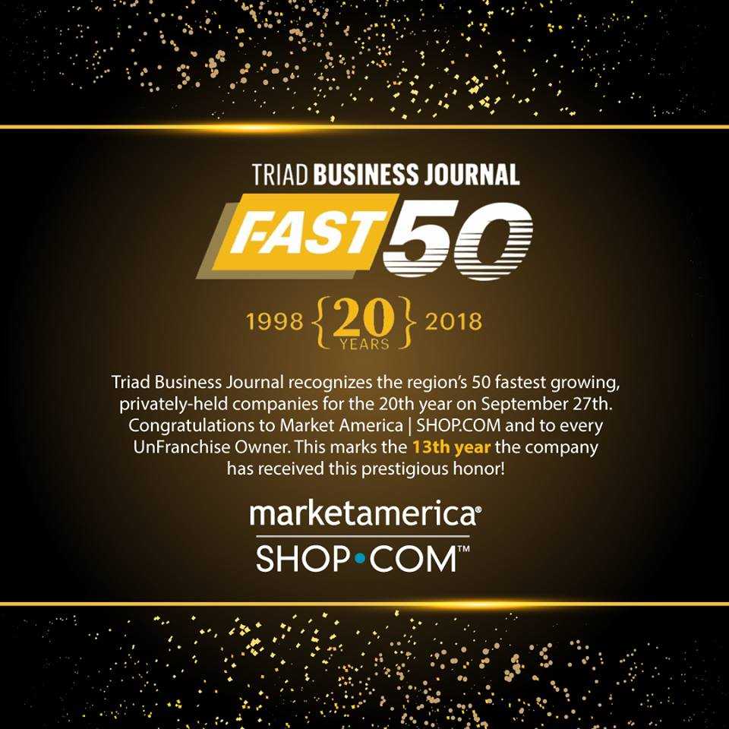
Notes:
Triad Business Journal has again named Market America | SHOP.COM to its Fast 50 list of the 50 fastest-growing privately held companies in the Piedmont Triad region of North Carolina. The 2018 recognition marks the 13th time Market America |SHOP.COM has made the annual list since it began in 1998, reflecting the company’s strong growth year after year.

Slide 43
“One of our key goals as a company is to provide UnFranchise® Owners with the most amazing, cutting-edge, professional digital tools and video resources to help promote products, build branding, launch campaigns and programs, and educate,” Chairman and CEO JR Ridinger writes on his blog.
Market America | SHOP.COM took four of the 39th Annual Telly Awards for 2018, matching its four wins in 2017. The Telly Awards annually showcases the best work created within television and across video, for all screens.
The company also won Telly Awards in 2012, 2013, 2014 and 2015. It’s one of an elite group of current and past winners that includes Microsoft, HBO, Bloomberg, Condé Nast, ESPN, MLB.com and more.

Slide 44
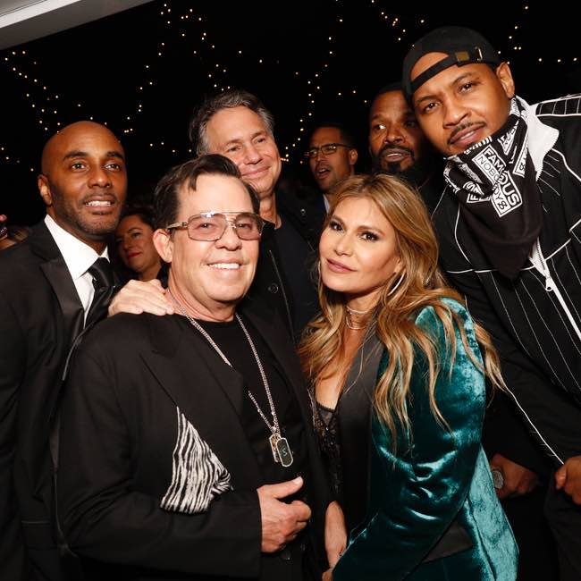
Lumiere De Vie Hommes Launch Party

Slide 45
FOR YOU!!

Slide 47
Be our
KOL
Considerations as a KOL:
Total Cashback earned
Total PS IBV earned
Total PS Amount spent
Total order count
Total BV earned
Total IBV Commission earned

Slide 48
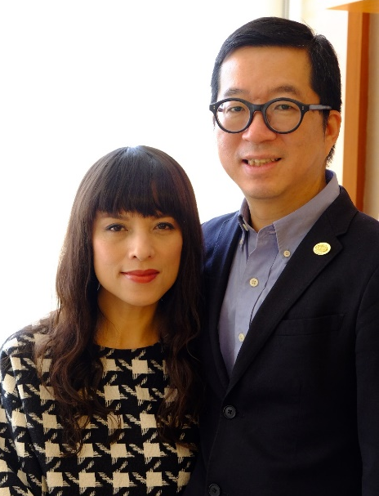
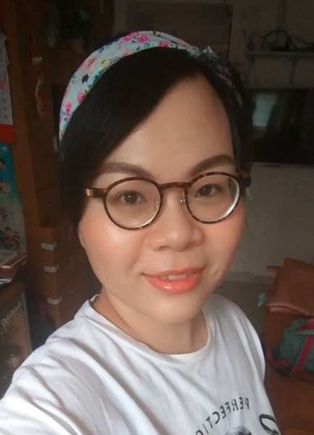
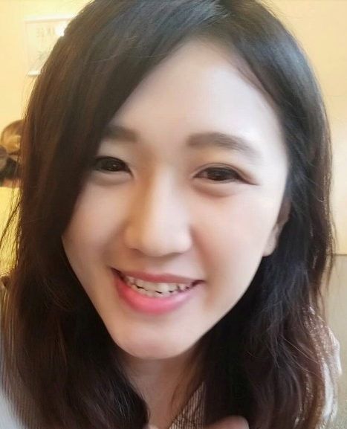
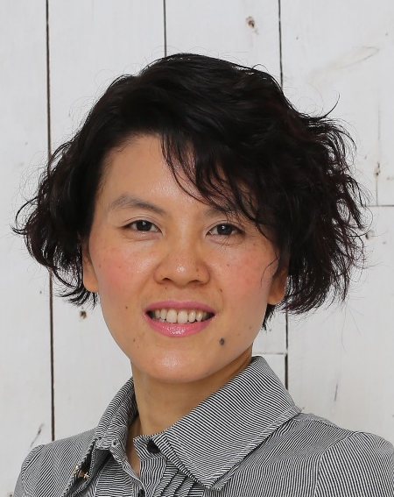
Calvin Ip & Rose Wong
Lilian Chan
Chan Wing San
Ann Cheung
Hong Hung Ying
Wong Pui Man
Lai Wai Ho
Tsang Ching Ping
Kawae Cheung

